Slide 1

Section Overview
New Video File

Slide 2





Introduction to HashiCorp Packer

Slide 3
Introduction to HashiCorp Packer
Section Overview
What is Packer?
Installing Packer
Primary Use Cases
Interacting with Packer (CLI)
Core Components
Packer Workflow

Slide 4
Why Use Packer?
New Video File

Slide 5
Why Use Packer?

Slide 6











Evolving Architecture at Enterprises
Location
On-Premises
Public Cloud
Containers
Development
Platform
Each Platform Requires Its Own Type Of Image

Slide 7




Automate Image Builds Across Platforms
Golden Images For All Your Workloads
Amazon
Machine
Image
Artifact
Repository
Packer
Config
VMware
Template
Code
Commit
Pipeline
Job
Packer
Build
Azure
Managed
Image
Google
Compute
Image

Slide 8


Maintain Consistency Across Workloads
Application
Workload
Application
Workload
Application
Workload
Provision Workloads
From Image
Application
Workload
Application
Workload
Application
Workload
Core
Machine
Image
Application
Workload
Application
Workload
Generate New Image
From Core Image
New
Machine
Image
Provision Workloads
From New Image
Application
Workload
Application
Workload
Application
Workload
Application
Workload
New Custom
Packer Config

Slide 9










Building Your Ideal Image for Workloads
Manufacturer Image (MS, RedHat, etc)
Manufacturer ISO File (Boot File, Image)
Image from Cloud Provider (Marketplace)
Custom Image Built Internally
Image Previously Built by Packer
Files
Tools
Original
Machine
Image
Scripts
Security
New Machine
Image
Packages
Config
Management
Updates
Secrets
Packer Build

Slide 10
Hello, Packer!
New Video File

Slide 11
Hello, Packer!

Slide 12






HashiCorp Suite of Tools

Slide 13



What is HashiCorp Packer?
Open-Source Machine Image Creation Tool
Automates the Installation and Configuration on Packer-made Images
Works with Multiple Platforms – Even from the Same Configuration
Eliminates Manual Steps for Golden Image Creation

Slide 14




Primary Use Cases
Establish an Image Factory
Based on New Commits for Continuous Delivery
Automate Your Monthly Patching
For New/Existing Workloads
Create Golden Images
Across Platforms and Environments
Create Immutable Infrastructure
Using Packer in CI/CD Pipeline

Slide 15


Benefits of Using Packer
Version Controlled
Consistent Images
Automate Everything
Images are Defined and Versioned as Code
Cross-Platform Consistency
Stop the Manual
Madness
Rather than the manual control of images, using Packer allows you to version control your images to simplify long-term management and updates within the organization
When you use multiple platforms for workloads, maintaining like-for-like images becomes a demanding task. Packer can assist with management across multiple platforms.
Manually having to manage images across multiple platforms is prone to human-error and creates unneeded administration overhead.
=

Slide 16
Core Components of Packer
New Video File

Slide 17
Core Components of Packer

Slide 18
Core Components
HashiCorp Packer builds images using a template
Templates can be built using either JSON(old) or HCL2(recommended for Packer 1.7.0+)
Template defines settings using blocks:
Original Image to Use (source)
Where to Build the Image (AWS, VMware, OpenStack)
Files to Upload to the Image (scripts, packages, certificates)
Installation and Configuration of the Machine Image
Data to Retrieve when Building

Slide 19
Core Components
Template Example (HCL2)
source "amazon-ebs" "aws-example" {
ami_name = "${var.ami_name}"
instance_type = "t3.medium"
region = "us-east-1"
source_ami_filter {
filters = {
name = "${var.source_ami_name}"
root-device-type = "ebs"
virtualization-type = "hvm"
}
owners = ["amazon"]
}
ssh_username = "ec2-user"
subnet_id = "${var.subnet_id}"
tags = {
Name = "${var.ami_name}"
}
vpc_id = "vpc-1234567890"
}
build {
sources = ["source.amazon-ebs.aws-example"]
provisioner "file" {
destination = "/tmp"
source = "files"
}
provisioner "shell" {
script = "scripts/setup.sh"
}
provisioner "shell" {
script = "scripts/vault.sh"
}
}

Slide 20






Core Components
Source
Builders
Variables
Provisioner
Communicators
Post-Processors

Slide 21
Only available in HCL templates
Source
Source defines the initial image to use to create your customized image. Any defined source is reusable within build blocks
For example:
Building a new AWS image (AMI), you need to point to an existing AMI to customize
Creating a new vSphere template requires the name of the source VM
Building new Google Compute images needs a source image to start
azure.pkr.hcl
source "azure-arm" "azure-arm-centos-7" {
image_offer = "CentOS"
image_publisher = "OpenLogic"
image_sku = "7.7"
os_type = "Linux"
subscription_id = "${var.azure_subscription_id}"
}

Slide 22
Builders
Builders are responsible for creating machines from the base image, customizing the image as defined, and then creating a resulting image
Builders are plugins that are developed to work with a specific platform (i.e., AWS, Azure, VMware, OpenStack, Docker)
Everything done to the image is done within the BUILD block
This is where the customization "work" happens
azure.pkr.hcl
build {
source = ["source.azure-arm.azure-arm-centos-7"]
provisioner "file" {
destination = "/tmp/package_a.zip"
source = "${var.package_a_zip}"
}
}
Uses the Azure builder to create
a new Azure Machine Image
packer.io/docs/builders

Slide 23

Provisioners
Provisioners use built-in and third-party integrations to install packages and configure the machine image
Built-in integrations include file and different shell options
Third-party integrations include:
Ansible – run playbooks
Chef – run cookbooks
InSpec – run InSpec profiles
PowerShell – execute PowerShell scripts
Puppet – run Puppet manifest
Salt – configure based on Salt state
Windows Shell – runs commands using Windows cmd
Initial
Image
Packer
Build
Configuration
Applications
Provisioners
Scripts
Final
Image

Slide 24



Post-Processors
Post-processors are executed after the image is built and provisioners are complete. It can be used to upload artifacts, execute uploaded scripts, validate installs, or import an image
Examples include:
Validate a package using a checksum
Import a package to AWS as an Amazon Machine Image
Push a Docker image to a registry
Convert the artifact into a Vagrant box
Create a VMware template from the resulting build
Post-Provisioners
Validate
Package
Initial
Image
Packer
Build
Final
Image
Execute
Script
Import to
AWS

Slide 25
Communicators
Communicators are the mechanism that Packer will use to communicate with the new build and upload files, execute scripts, etc.
Two Communicators available today:
SSH
WinRM
Initial
Image
SSH
New
Linux
Build
Packer

Slide 26
Variables
HashiCorp Packer can use variables to define defaults during a build
Variables can be declared in a .pkrvars.hcl file or .auto.pkrvars.hcl, the default .pkr file, or any other file name if referenced when executing the build.
You can also declare individually using the –var option
Variable declaration block:
variable "image_id" {
type = string
description = "The id of the machine image (AMI) to use for the server."
default = "ami-1234abcd"
validation {
condition = length(var.image_id) > 4 && substr(var.image_id, 0, 4) == "ami-"
error_message = "The image_id value must be a valid AMI id, starting with \"ami-\"."
}
}

Slide 27
Installing Packer
New Video File

Slide 28




About HashiCorp Packer
HashiCorp Packer is platform agnostic….meaning it can be installed and run on many different underlying platforms
Cloud-Based Machines (AWS Instances, Azure Virtual Machines, Google Compute)
VMware Virtual Machines
Physical Servers
Desktop/Laptop

Slide 29

About HashiCorp Packer
HashiCorp Packer is also available for many different operating systems:
macOS
Windows
Linux
FreeBSD
OpenBSD
Solaris

Slide 30
Using Packer
1
Install Packer
2
Create Template
More information in the
Writing Packer Templates
Section
3
Build Machine Image
More information in this
Section and throughout the course

Slide 31
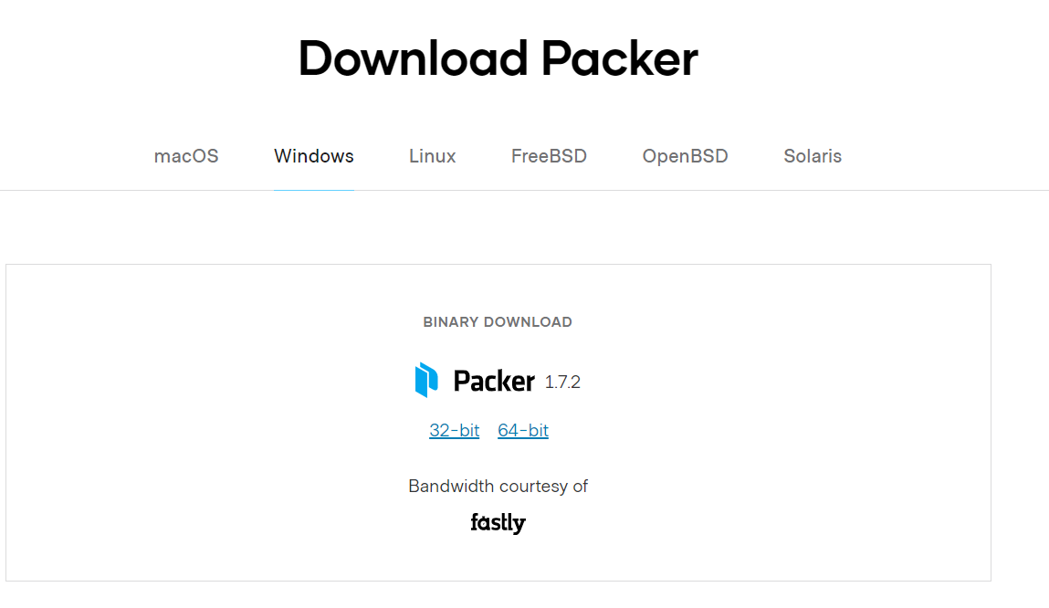
Install HashiCorp Packer
So where do I download Packer?
packer.io
releases.hashicorp.com/packer
You can also download/install Packer using your preferred package manager (apt, yum, homebrew, chocolatey)
Terminal
$ curl -fsSL https://apt.releases.hashicorp.com/gpg | sudo apt-key add -
$ sudo apt-add-repository "deb [arch=amd64] https://apt.releases.hashicorp.com $(lsb_release -cs) main"
$ sudo apt-get update && sudo apt-get install packer

Slide 32



Install HashiCorp Packer
Manual Install
$PATH
unzip
move
packer.zip
Packer binary
Set Path To Executable

Slide 33
Installing Packer
Lab

Slide 34
The Packer Command Line
New Video File

Slide 35
Packer Command Line
The command line interface (CLI) is how users/applications interact with Packer
There is no UI or API for Packer
Terminal
$ packer
Usage: packer [--version] [--help] <command> [<args>]
Available commands are:
build build image(s) from template
console creates a console for testing variable interpolation
fix fixes templates from old versions of packer
hcl2_upgrade transform a JSON template into an HCL2 configuration
inspect see components of a template
validate check that a template is valid
version Prints the Packer version

Slide 36
Packer Command Line
packer autocomplete
Install Packer autocomplete to enable tab completion when using the CLI:
Terminal
$ packer –autocomplete-install
$ packer p
plugin build
$ packer build -
-color -debug -except -force -machine-readable -on-error -only -parallel -timestamp -var -var-file
Type p and hit <tab>

Slide 37
Packer Command Line
Similar to any other command-line based tool, Packer uses a subcommand and additional arguments to execute Packer functionality
All commands start with the 'packer' command
Terminal
$ packer <sub-command> <argument> <argument>
Terminal
$ packer build –var-file=vars.pkr.hcl aws.pkr.hcl
Packer
command
Sub
command
Argument
(option)
Template
Name

Slide 38
Packer Command Line
Subcommands available in Packer:
build - build image(s) from template
console - creates a console for testing variable interpolation
fix - fixes templates from old versions of packer
hcl2_upgrade - transform a JSON template into an HCL2 configuration
inspect - see components of a template
validate - check that a template is valid
version - prints the Packer version
Most of the commands accept or require flags or arguments to execute the desired functionality

Slide 39
Packer Command Line
packer build
The packer build command takes a Packer template and runs all the defined builds to generate the desired artifacts. The build command provides the core functionality of Packer.
Important Options/Arguments
-debug – enables debug mode for step-by-step troubleshooting
-var – sets a variable in the Packer template
-var-file – use a separate variable file
Terminal
$ packer build base-image.pkr.hcl

Slide 40
Packer Command Line
packer fix
The packer fix command takes a template and finds backwards incompatible parts of it and brings it up to date so it can be used with the latest version of Packer. Use after you update Packer to a new release version.
JSON ONLY COMMAND
As of Packer 1.7.2, the command is not yet available with HCL2 templates yet, as it is not yet needed.
Terminal
$ packer fix old-template.json > new-template.json

Slide 41


Packer Command Line
packer fmt
The packer fmt command is used to format your Packer templates and files to the preferred HCL canonical format and style.
Terminal
$ packer fmt base-image.pkr.hcl
Not Formatted
Formatted Correctly
base-image.pkr.hcl
base-image.pkr.hcl
variable "vpc_id" {
type=string
default="vpc-06626bb552084b94b"
}
variable "vpc_id" {
type = string
default = "vpc-06626bb552084b94b"
}
packer fmt

Slide 42
Packer Command Line
packer inspect
The packer inspect shows all components of a Packer template including variables, builds, sources, provisioners and post-processsors
Terminal
$ packer inspect aws-ubuntu.pkr.hcl
Packer Inspect: HCL2 mode
> input-variables:
> local-variables:
> builds:
> Amazon AMI:
sources:
amazon-ebs.ubuntu
provisioners:
shell
post-processors:
0:
manifest

Slide 43
Packer Command Line
packer validate
The packer validate will validate the syntax and the configuration of your Packer template. This is your first validation for templates after writing or updating them.
Terminal
Template validated
(no error message)
$ packer validate temp.pkr.hcl
Terminal
Template did not validate
successfully
(error shown)
$ packer validate vmware-image.pkr.hcl
Template validation failed. Errors are shown below.
Errors validating build 'vmware'. 1 error(s) occurred:
* Either a path or inline script must be specified.

Slide 44
Packer Command Line
packer hcl2_upgrade
The packer hcl2_upgrade translates a template written in the older JSON format to the new HCL2 format.
Terminal
$ packer hcl2_upgrade base-image.json
Successfully created base-image.json.pkr.hcl
Converted JSON to HCL2 format
base-image.json
base-image.json.pkr.hcl
{
"variables": {
"deployment_version": "version-1",
"ami_prefix": "amzn2",
"app_name": "consul",
"consul_version": "1.9.3",
},
variable "deployment_version" {
type = string
default = "version-1"
}
variable "ami_prefix" {
type = string
default = "amzn2"
}
variable "app_name" {
type = string
default = "consul"
}

Slide 45
Packer Command Line
Environment Variables
Packer has a few environment variables that you should know:
PACKER_LOG – enable Packer detailed logs (off by default)
PACKER_LOG_PATH – set the path for Packer logs to specific file (rather than stderr)
PKR_VAR_xxx – define a variable value using ENV rather than in a template
Terminal
Enable Detailed Logs
Set a path for logs
Run the packer build
$ export PACKER_LOG=1
$ export PACKER_LOG_PATH=/var/log/packer.log
$ packer build base-image.pkr.hcl
Terminal
$ export PKR_VAR_aws_region=us-east-1
$ packer build aws-base-image.pkr.hcl
…
Declare a value for the aws_region variable using ENV

Slide 46
Packer CLI
Lab
Demo:
Go through most of the commands
Make sure to do an hcl2_upgrade

Slide 47
The Packer Workflow
New Video File

Slide 48




The Packer Workflow
AWS Example
HCL2
Template
Packer
Build
Provision
Instance
Run
Provisioners
Create
AMI
Register
AMI
Destroy
Instance
New Image
Artifacts

Slide 49
The Packer Workflow
Lab
Show an AWS build from the CLI and showcase the build in the AWS console

Slide 50
Section Recap
New Video File

Slide 51
Introduction to HashiCorp Packer
Section Recap
What is Packer?
Installing Packer
Primary Use Cases
Interacting with Packer (CLI)
Core Components
Packer Workflow

Slide 52
END OF SECTION

